Slide 1
PatronKiosk
November 16th, 2018

Slide 2
Our ICT Philosophy
Identity - Security, Authentication and Access
Infrastructure - Communications, Data and Connectivity
Insights - Software, Data and Understanding
Notes:
2:00PM – 2:10PM

Slide 3
Why did the industry move down the bespoke hardware path?
Complexity of solutions and options at the time
Lack of hardware suppliers
Sophistication and understanding of RFID across the tech industry
Lack of internal capacity to undertake ICT
Reliance on Council, or
Limited size of ICT team
Notes:
2:15PM – 2:40PM

Slide 4
PatronKiosk
Enabling Access
Notes:
2:40PM – 3:00PM

Slide 5
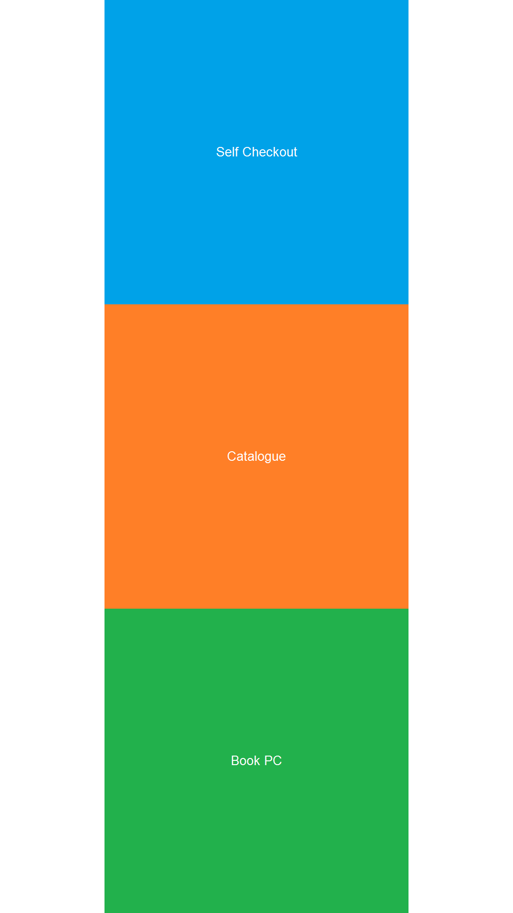
Our Solution
Primary Outcomes
avoid single use devices
overlay software
lock down a computers functions to a set of software/websites
clean user interface
Project Scope
Hardware (non-specific)
All-in-one touch-screen PC
Thermal Printer
Barcode Scanner
RFID Pad
Software (non-specific)
Self-Checkout
Catalogue
Computer Booking
PatronKiosk
Notes:
2:10PM – 2:15PM

Slide 6
Why Open Source?
Your gateway to our solutions

Slide 7
Open Source through MIT licence and GitHub
Every Library has great solutions to problems, we just don’t know it
We want to engage the library community to help improve this solution/offering
Our belief is that if we start openly sharing our solutions more of the community will follow suite
https://github.com/CaseyCardiniaLibraries/PatronKiosk
If you haven't already created a GitHub account for your Library Service get on there and create one for free.
If you are lucky enough to have DGR status you can even get upgraded to GitHub Enterprise for free - https://github.com/nonprofit

Slide 8
Questions?
What’s Next?

